Slide 1


MAHENDRA ENGINEERING COLLEGE (Autonomous)
CATCH ‘25 – Hackathon
Name of the College : Mahendra Institute of technology
Name of the Team :FURIOUZ CODE
Name of the Team Leader : IMRAN.S.S
Name of the Department : CSE
Problem Statement : AI-POWERED TRAFFIC MANAGEMENT SYSTEM
Date : DD/MM/YYYY

Slide 2





CREW DETAILS
IMRAN.S.S
KALIDASH.M
LOGESHWARAN.M
KISHORE KUMAR.V
KATHIRAVAN.E
NAME OF THE STUDENT | YEAR | DEPARTMENT | DESIGNATION | E MAIL ID
IMRAN.S.S | II | CSE | TEAM LEADER | Imranss1309@gmail.com
KISHORE KUMAR.V | II | CSE | CODER | Kishorekumarv25@gmail.com
KALIDASH.M | II | CSE | SUB LEADER | kalidhas00004@gmail.com
LOGESHWARAN.M | II | CSE | CODER | logeshm15112005@gmail.com
KATHIRAVAN.E | II | CSE | TEAM MEMBER | kathiravankathiravan2305@gmail.com

Slide 3
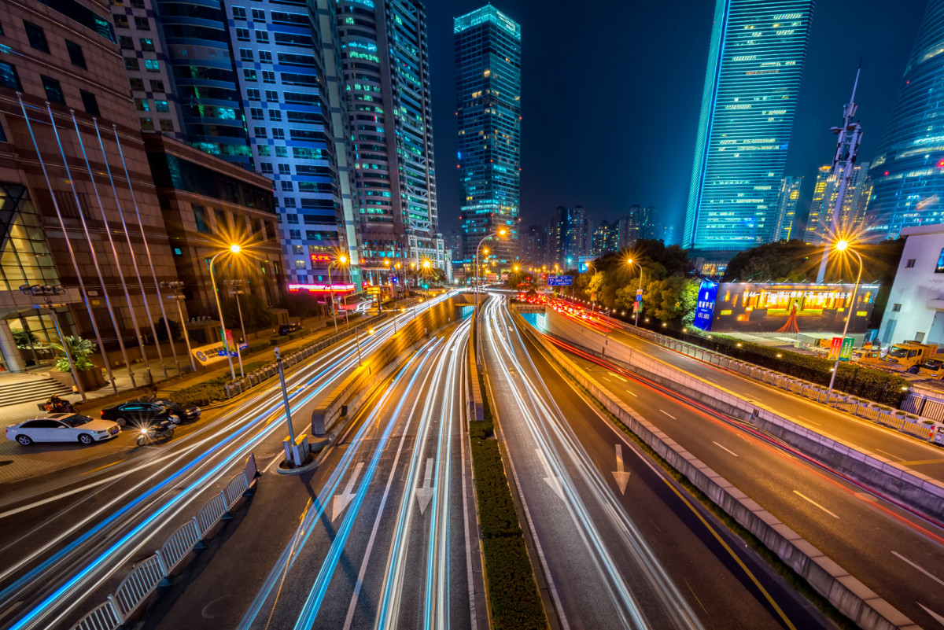
ABSTRACT
Smart Route Optimization uses AI-powered real-time traffic navigation to reduce congestion, optimize travel, and improve efficiency.

Slide 4


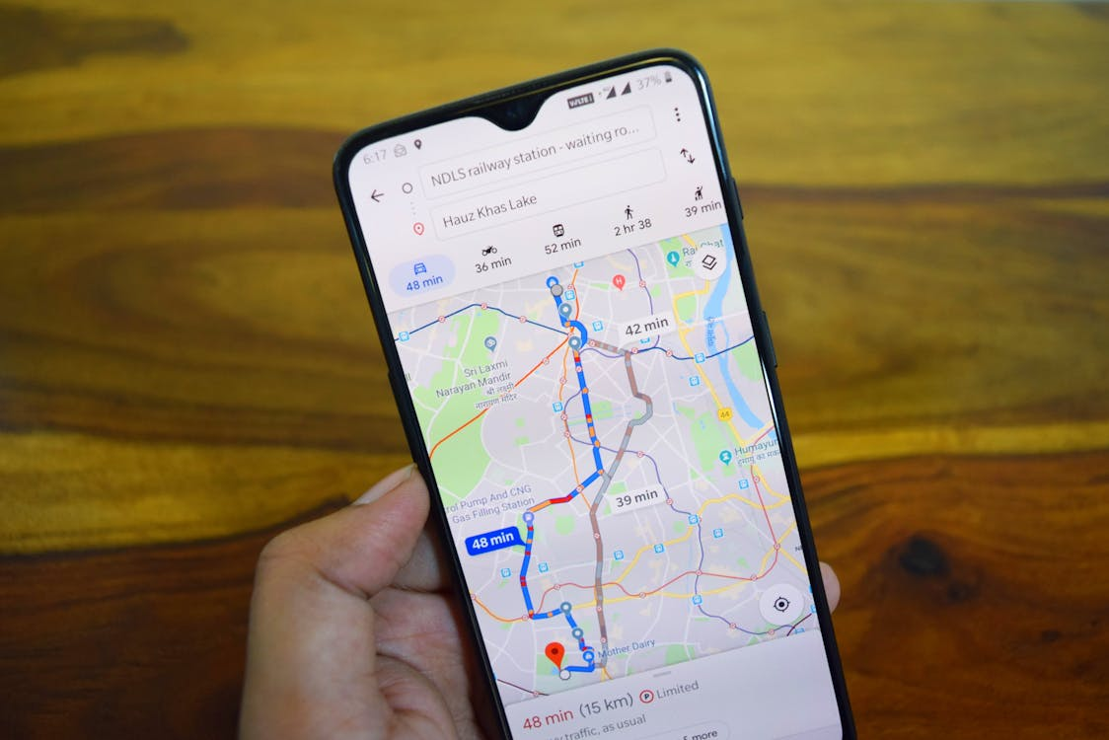





MODULE LIST
SOFTWARE
HARDWARE
CLOUD
/

Slide 5

REQUIREMENTS
1. Data Collection (GPS, IoT Sensors, Traffic Cameras)
2. AI Model Processing (Machine Learning)
3. Optimization (Real-time Dynamic Routing)
4. Navigation Interface (Mobile/Web)

Slide 6

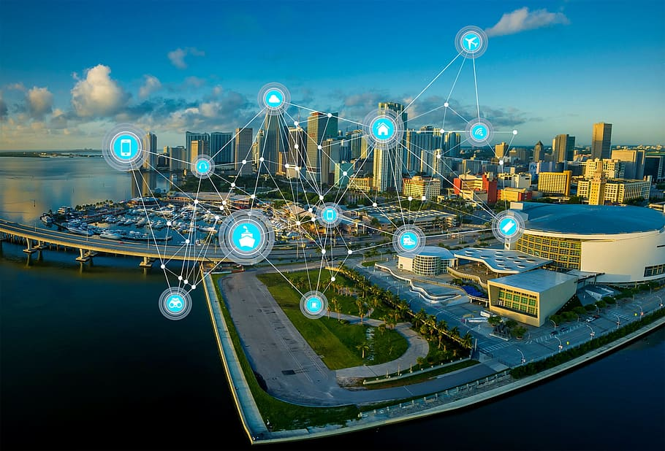

METHODOLIGIES OR ALGORITHMS FOCUSED
1. Machine Learning for traffic prediction
2. Dijkstra’s Algorithm for shortest path calculation
3. IoT integration for real-time traffic monitoring

Slide 7
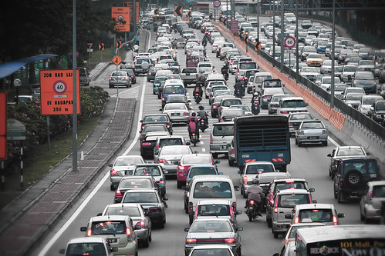
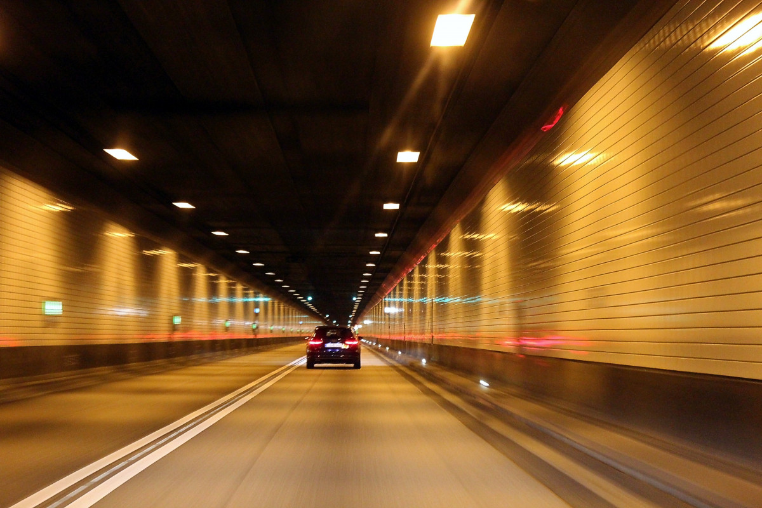
ANALYSIS OF THE PROJECT
• Traffic Density Prediction using AI
• Real-time Routing Adjustments based on congestion
• Performance Metrics: Travel time reduction, Fuel efficiency

Slide 8

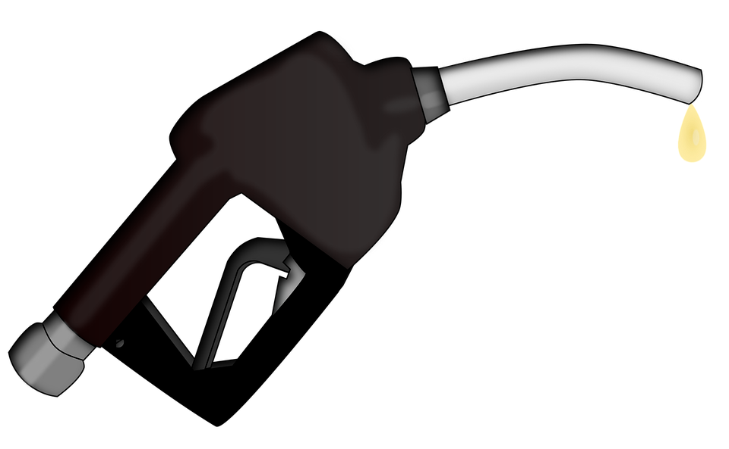
EXPECTED OUTCOME
✔ Reduced congestion
✔ Cost-effective logistics
✔ Improved emergency response times
✔ Smart city integration
Fuel storage

Slide 9
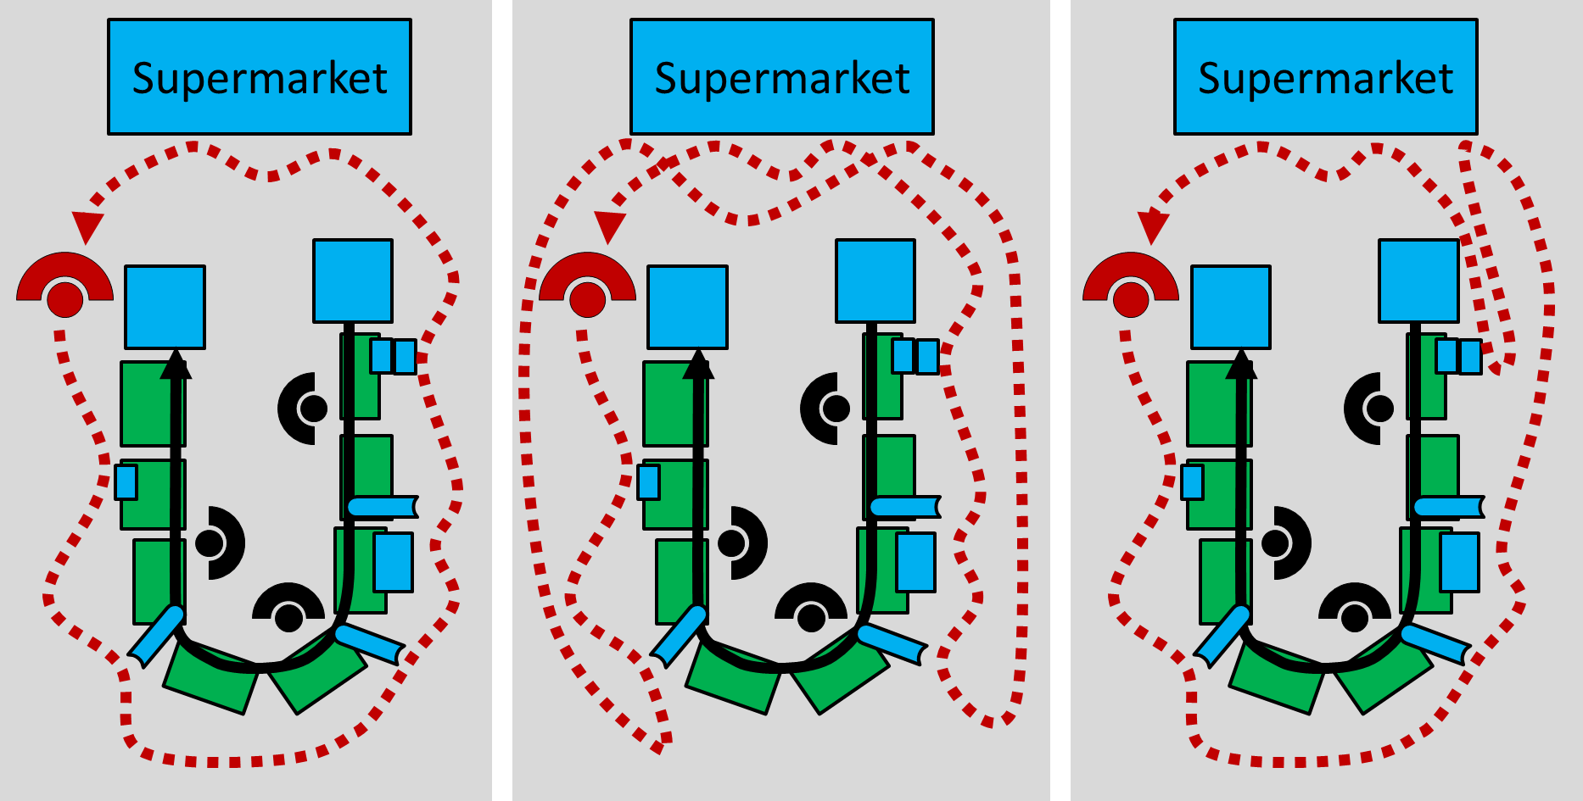
SOCIAL RELEVANCE
Reduces carbon emissions by optimizing fuel usage
Enhances road safety with AI-based navigation
Supports sustainable urban mobility
Improves daily commutes for millions

Slide 10


CONCLUSION AND FUTURE WORK
At conclusion by our app we will desing in the ai concept it will useful to guide people to drive in road
FUTURE WORK
🔹 Smart Route Optimization is an AI-powered solution to enhance traffic flow
🔹 Future Scope: Integration with EV charging stations, Blockchain for secure data, Voice-enabled AI Assistant

Slide 11
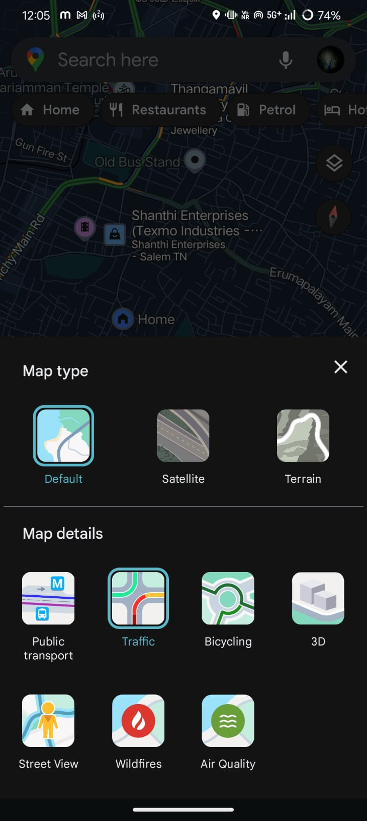
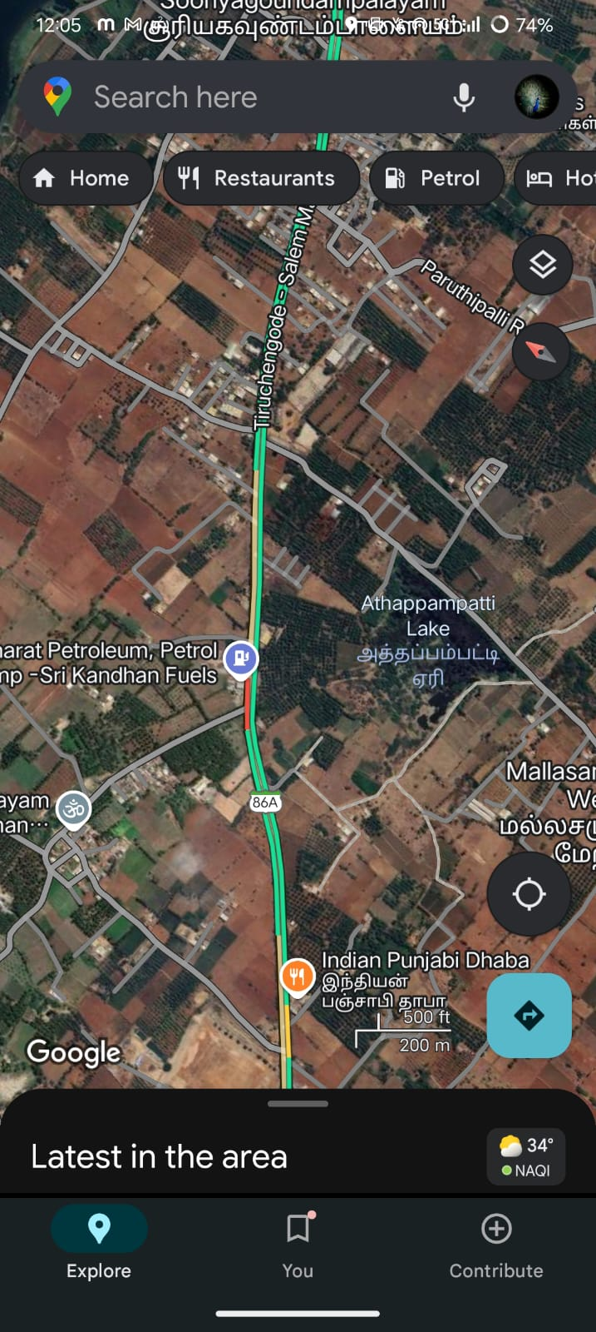
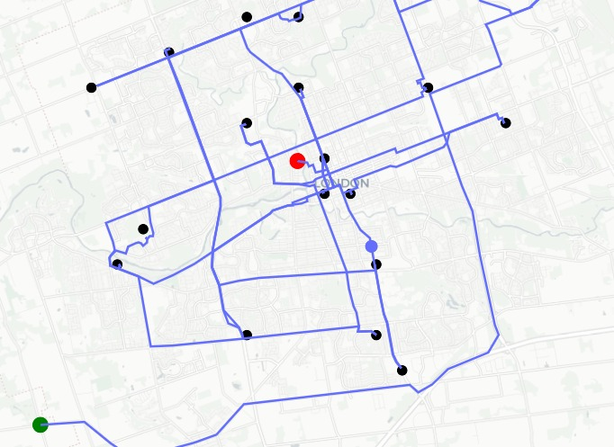
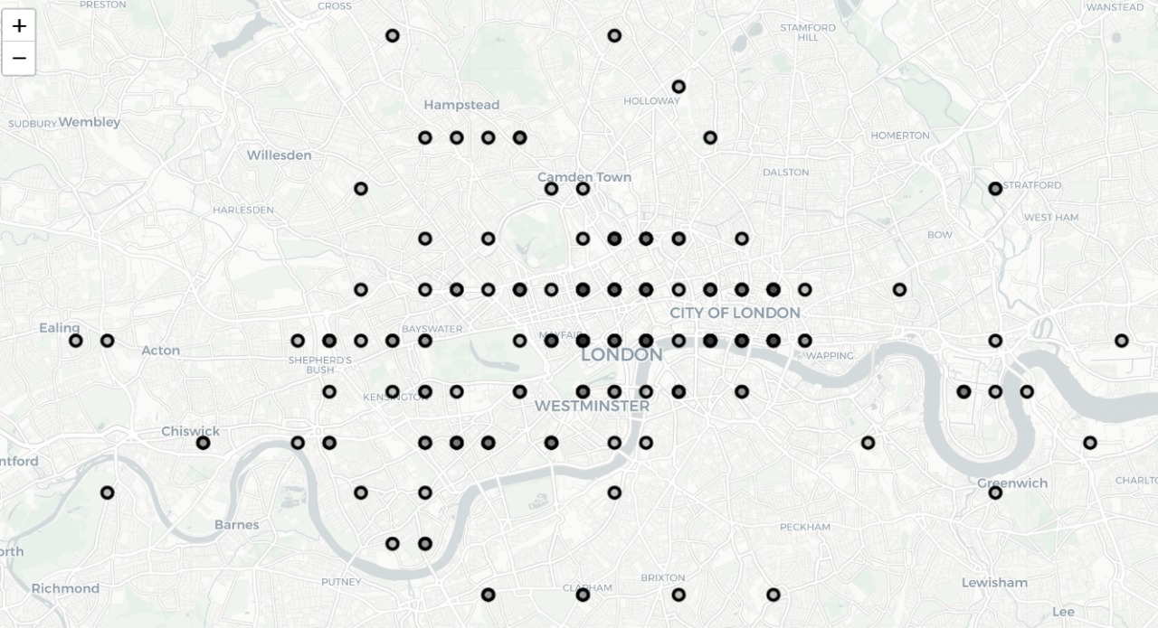
DEMONSTRATION SAMPLE INPUT
BEFORE:
AFTER:
Busy area
This is we
By using the website we found a smart route to avoid traffic.
By using google maps we will add a specification to identify the traffic

Slide 12
THANK YOU !

